Slide 1

Saving and Loading Model
Recitation 0.25
Introduction to Deep Learning – 11-785/685/485
Floride Tuyisenge

Slide 2
Agenda
Understanding Model Checkpointing
The Checkpointing Workflow
  The complete flow: Train → Save → Load
Saving Model Checkpoints
  Saving locally with torch.save()
  Saving to cloud with wandb Artifacts
Loading Model Checkpoints
  Loading .pth from local storage with torch.load()
  Downloading and loading .pth checkpoint from wandb artifacts
Checkpoint Management & Best Practices
  Organizing checkpoints
  Load specific parts of it
Live Demo: Complete Checkpointing Workflow
  Google Colab demonstration with a dummy Neural Network model

Slide 3
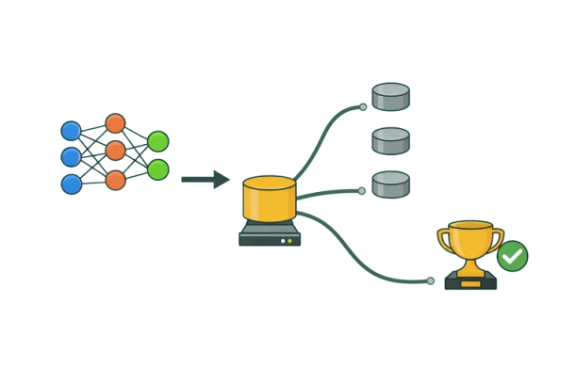
Understanding Model Checkpointing
The Challenge
Training deep learning models takes hours, days, or even weeks
What happens if your training crashes or gets interrupted?
What is Checkpointing?
Saving a complete snapshot of your training state at specific moments
Example: You are training for 100 epochs but your Colab session times out at epoch 47, so with checkpointing, you can resume from epoch 47 instead of restarting from epoch 0.
Includes: model weights, optimizer state, epoch number, and metrics
Why Do We Need Checkpoints?
Resume after crashes : Don't lose hours of work when sessions timeout or crash
Save your best model : Keep the model with best validation performance, even if training continues
Experiment flexibly :Try different strategies from any saved point without retraining from scratch

Slide 4
The checkpointing workflow
Local Session
(Training/Inference)
1. Save
torch.save()
4. Load
torch.load() + model.load_state_dict()
3. Download
wandb.restore()
Local Storage
(.pth files)
Weights & Bias
WandB
2. Upload
wandb.save()

Slide 5
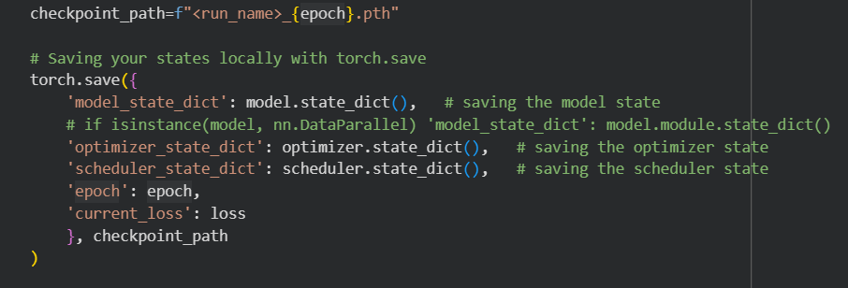
Saving Model Checkpoints(Locally)
Use torch.save() to save checkpoints locally
Saves a dictionary containing:
  • Model state_dict (weights and biases)
  • Optimizer state_dict
  • Scheduler state_dict
  • Current epoch and loss metrics
Dictionary is saved as a .pth file using Python's pickling

Slide 6
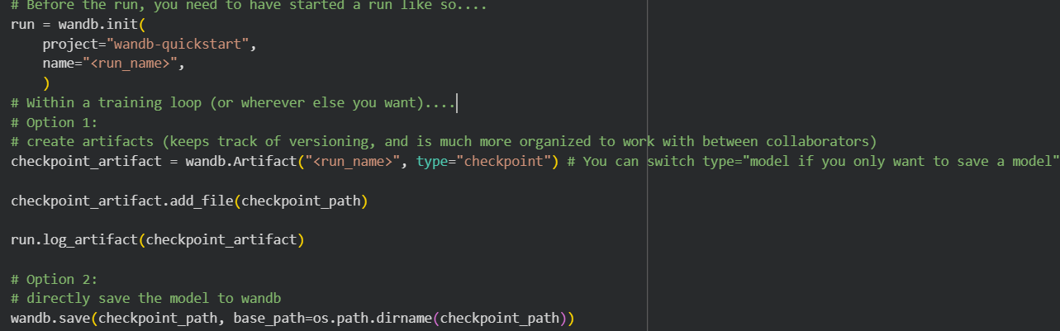
Saving Model Checkpoints(Wandb)
Initialize wandb run before training (wandb.init())
Two options to save to WandB:
  Option 1: Create artifact and add checkpoint file:
    wandb.Artifact(): creates versioned artifact
    artifact.add_file(): adds the .pth file
    run.log_artifact(): uploads to cloud
  Option 2: Use wandb.save() directly Simpler method for quick uploads

Slide 7
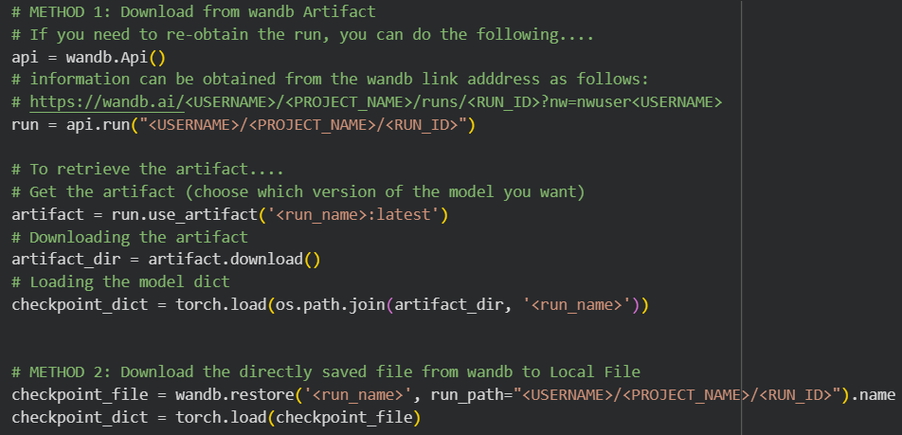
Loading Model Checkpoints from Wandb
Obtain the run object (if needed) using wandb.Api()
Two methods to download from WandB:
Method 1: Using Artifacts
  • run.use_artifact(): retrieve the artifact
  • artifact.download(): download to local
  • torch.load(): load the checkpoint dictionary
Method 2: Using wandb.restore()
  • Directly restore the file to local storage
  • Then load with torch.load()

Slide 8
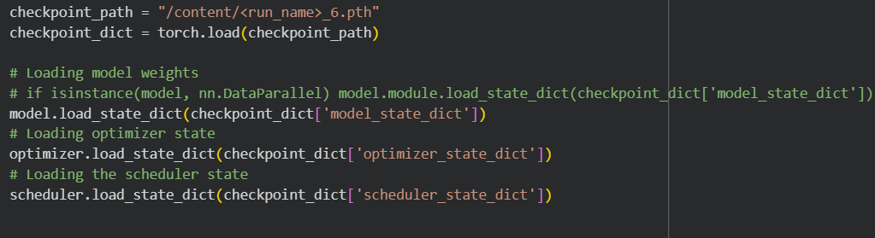
Loading Model Checkpoints Locally
Load checkpoint using torch.load(checkpoint_path)
Restore each component to your model:
  • model.load_state_dict() - load model weights
  • optimizer.load_state_dict() - restore optimizer
  •.load_state_dict() - restore scheduler scheduler
⚠️ Important
Model architecture must match exactly!
Optimizer/scheduler types must match checkpoint
However, some hyperparameters such as learning rate, momentum, etc. can be changed

Slide 9
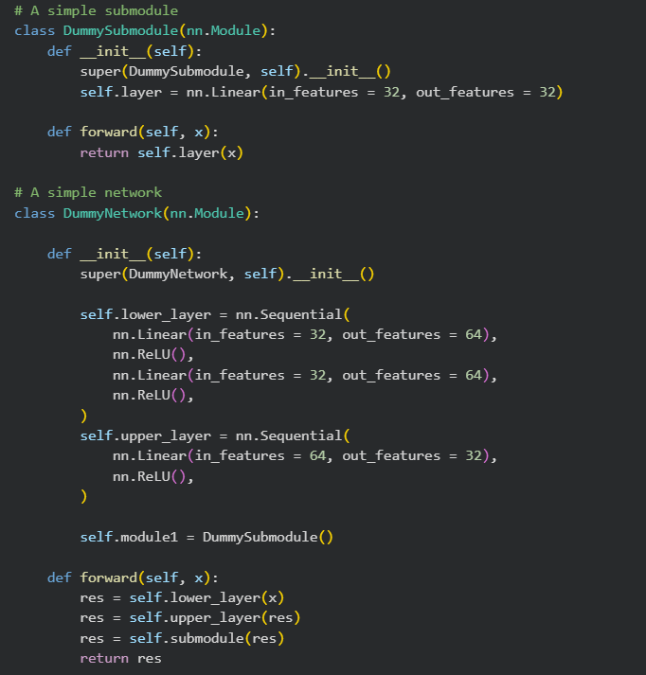
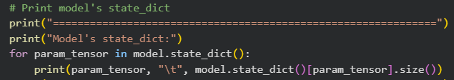
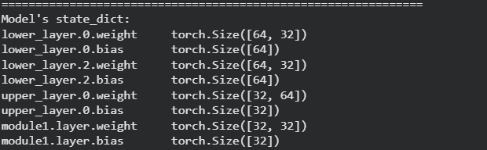
Checkpoint Management & Best Practices
Dummy Model:
Organize in submodules:
  • Break models into smaller nn.Module components
  • Makes code cleaner and reusable
Organize by class names and Sequential
  • Use nn. sequential for layer groups
  • Name layers descriptively (lower_layer, upper_layer)
Keys
Values

Slide 10
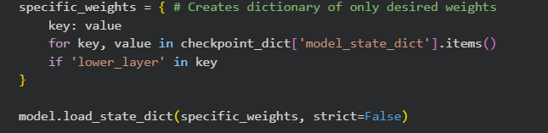
Checkpoint Management & Best Practices
Loading specific Parts of the Model
Loading Selective Weights:
  Filter out the weights you want into a dictionary
  • Loop through checkpoint_dict['model_state_dict']
  • Select only desired keys (e.g., 'lower_layer' in key)
  Load your weights with strict=False
  • model.load_state_dict(specific_weights, strict=False)
  • strict=False allows partial loading
⚠️ IMPORTANT:
Parameter names must match exactly, and Dimensions must match for loaded parameters

Slide 11
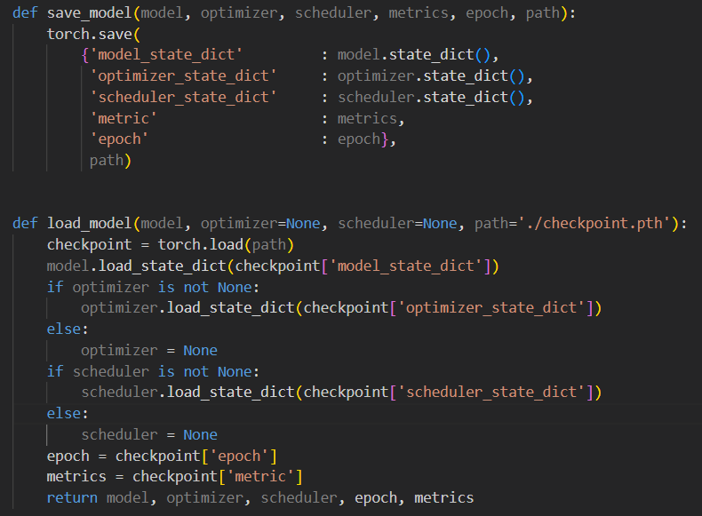
Saving and Loading Datapoint with HW Example
Local Saving:
  Store model, optimizer, scheduler, metrics, epoch in dictionary
  Save to local file with torch.save()
Local Loading:
  Load from local .pth file with torch.load()
  Restore components using load_state_dict()
  Handle optional optimizer/scheduler

